Slide 1
TITLE : RECOMMENDATION SYSTEM USING MACHINE LEARNING
Team Members:BB21
Orchu Venkata Ashok -20471A1242
Boligarla Penchala Pratap -20471A1208
Oruganti Jaya Krishna -20471A1243
Project Guide : Sk.MohammedJany -Assistant Professor

Slide 2
Abstract
Recommender systems are crucial for enhancing user experience and facilitating quick purchases in e-commerce, improving customer engagement and profitability.
The article discusses a proposed simple and understandable recommendation system tailored for book recommendations, aiming to aid readers in finding their next read efficiently.
The paper employs User Based Collaborative Filtering (UBCF) to measure performance in recommending books, highlighting the importance of effective similarity measures in enhancing the recommendation process.

Slide 3
Existing System
The Existing Systems Make recommendations based on the product that customer brought and they do not care about the how the user satisfied with the product
They don’t take the user feedback about a Particular Product
They don’t maintain the user feedback and data to recommend Products to the customer
So its effecting the accuracy of the recommendation

Slide 4
Proposed System
In this project we mainly focused on the users feedback data and ratings of the customer to that particular product is taken as tool for the accurate recommendation
The objective of the proposed project is to enhance movie recommendation accuracy for users.
It aims to improve the quality and scalability of the movie recommendation system by employing a Hybrid approach, which combines content-based filtering and collaborative filtering methods.
It includes dataset collections ,data cleaning ,data organizing and displaying to the user

Slide 5
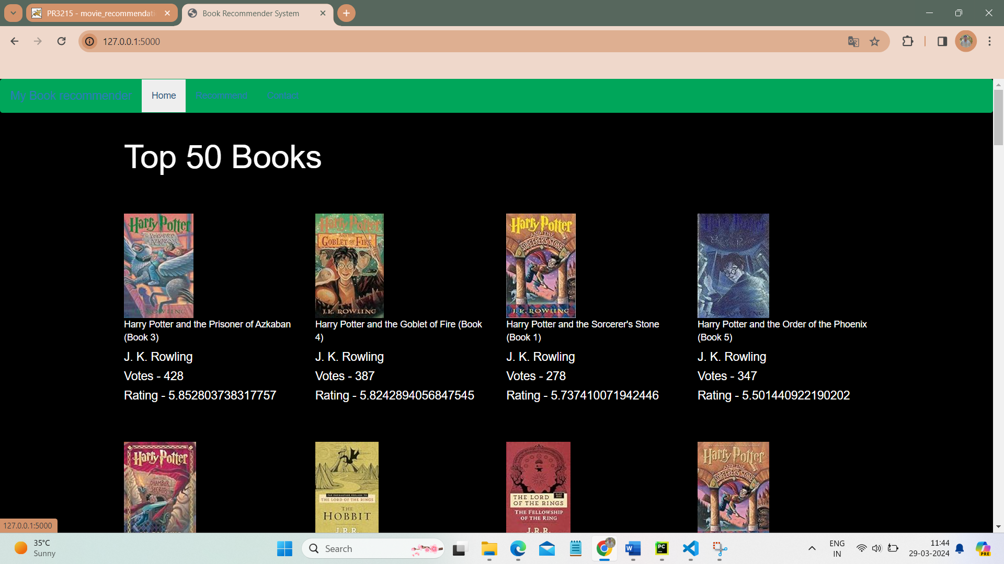
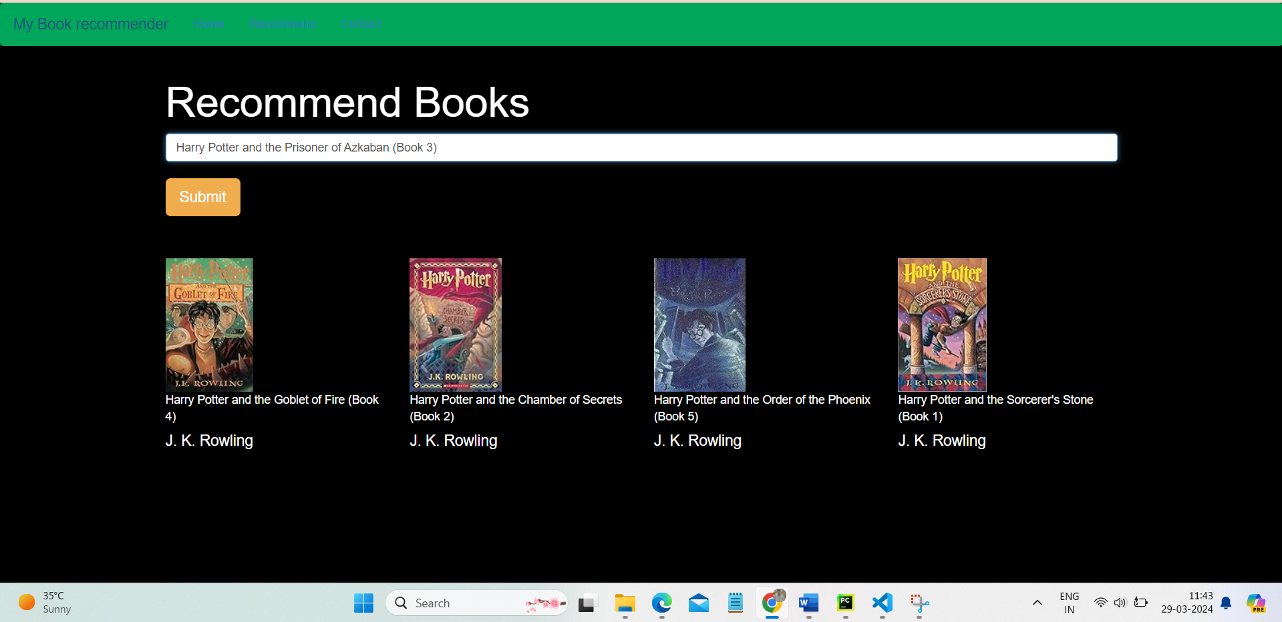
Output Screens

Slide 6
Conclusion
Improving the Accuracy of the recommendation system.
Improve the Quality of the movie Recommendation system.
Improving the Scalability.
Enhancing the user experience.

Slide 7
Thank you

